Slide 1
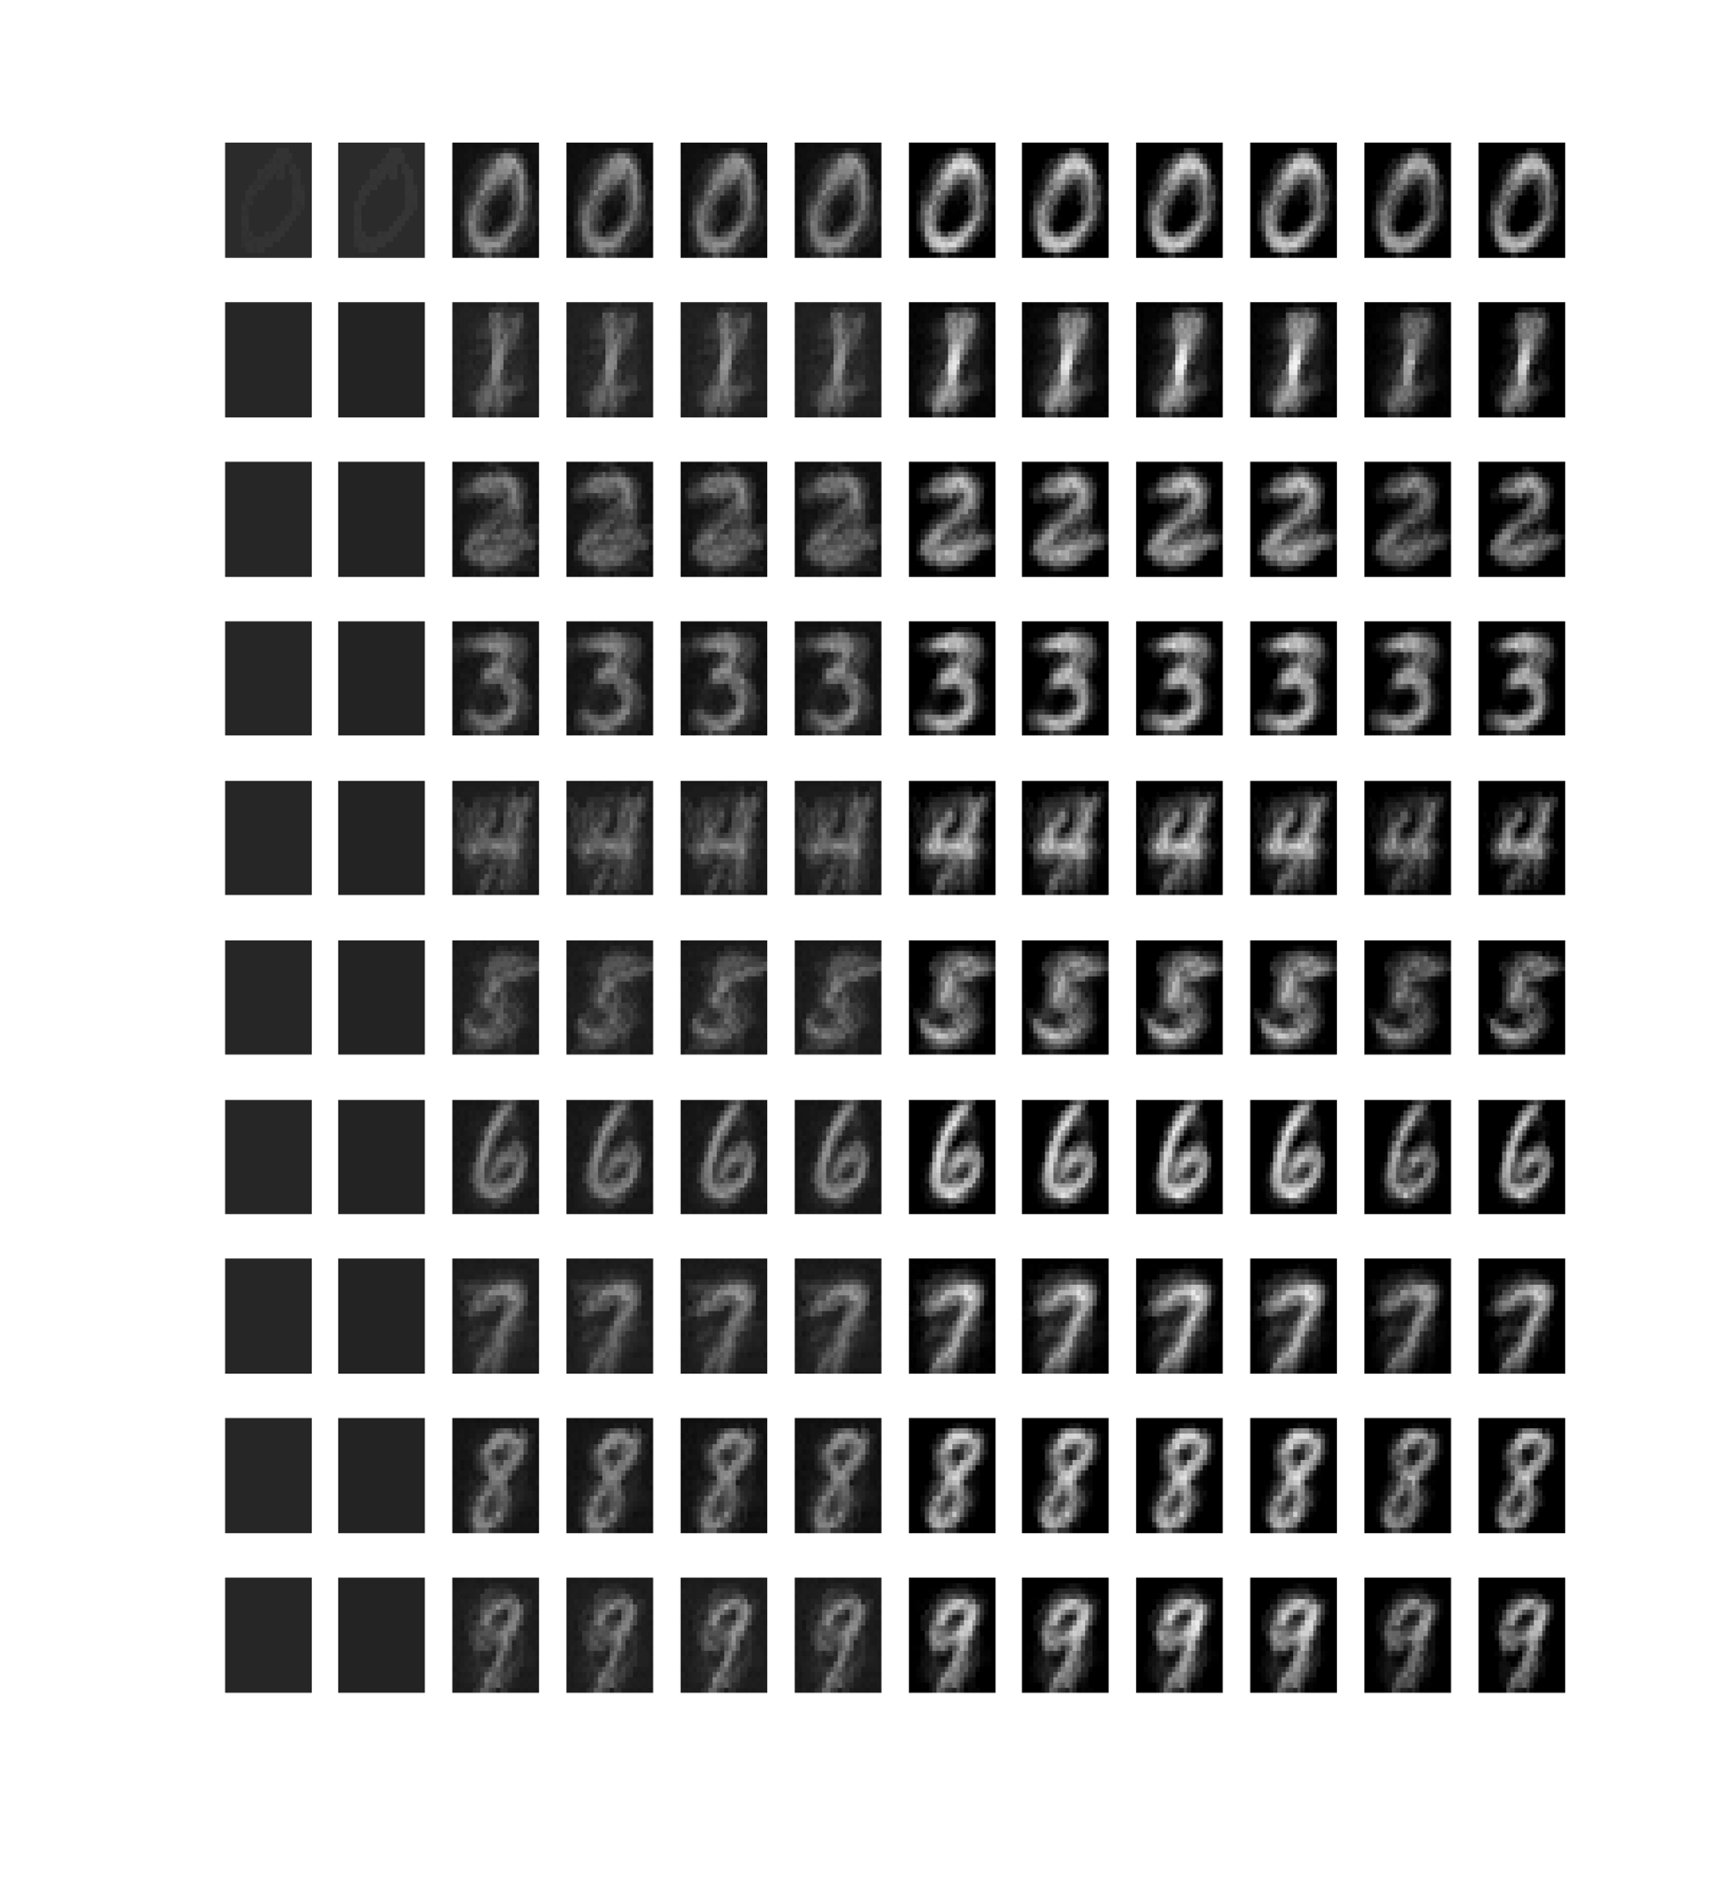
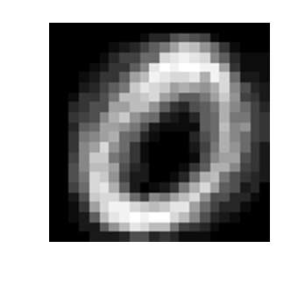
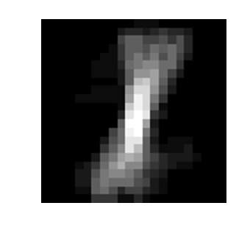
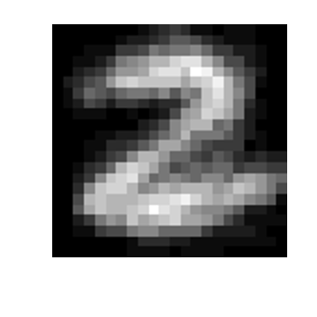
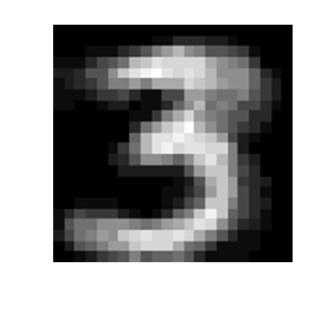
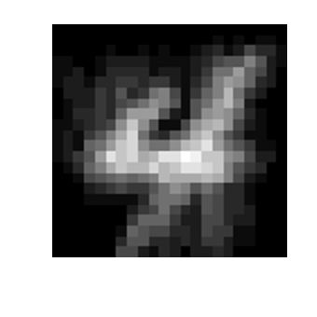
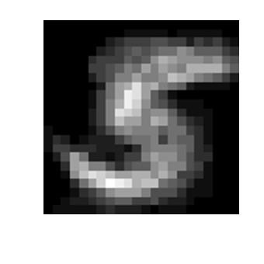
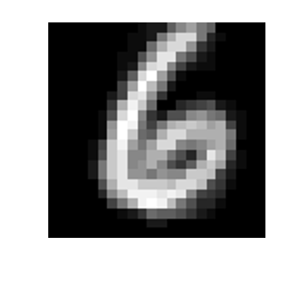
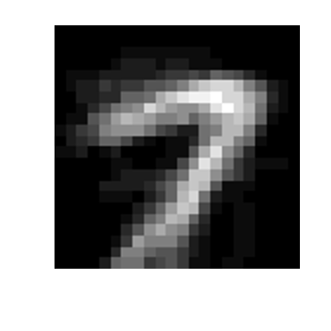
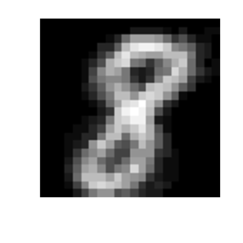
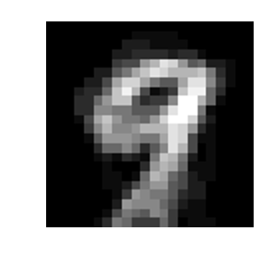
Late-phase plasticity
sequence I
XI
XX
XXI
class
0
0
9
0
9
noise
dataset
mean
1
2
201
202
219
220
381
382
399
400
401
402
state #

Slide 2
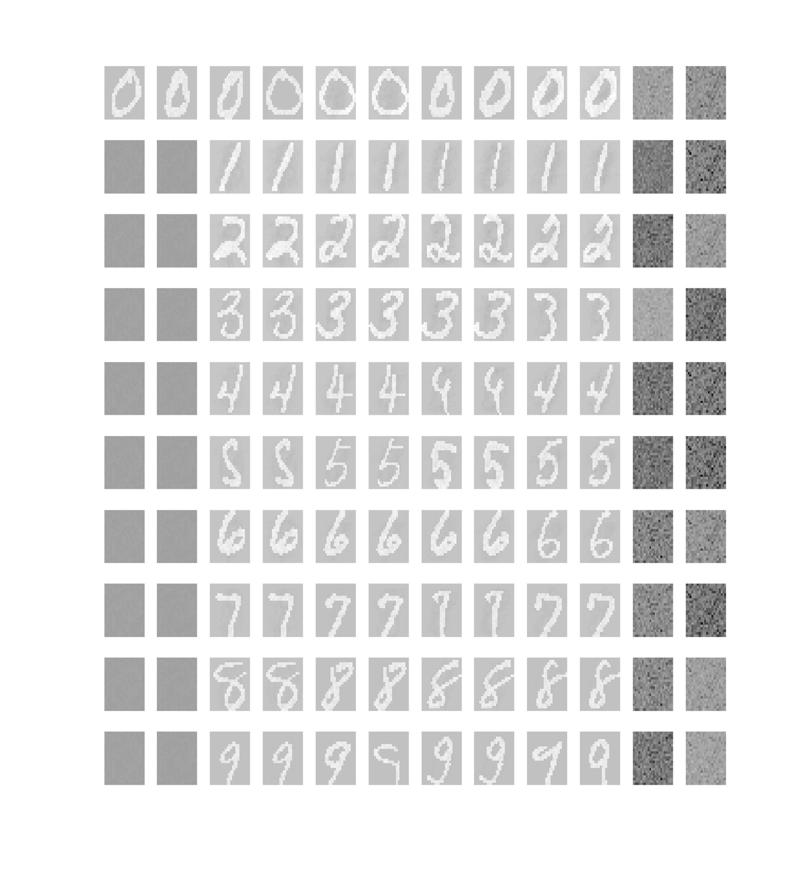
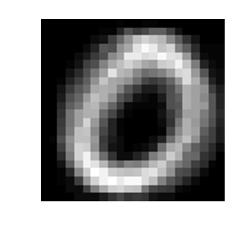
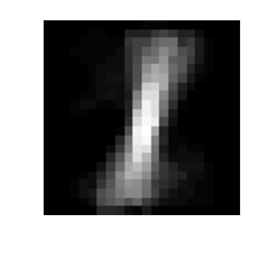
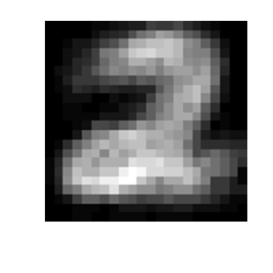
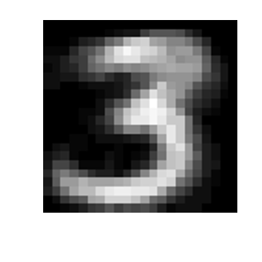
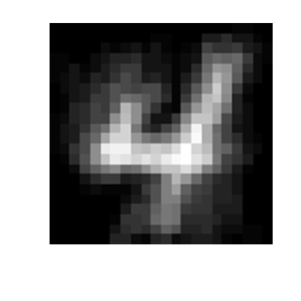
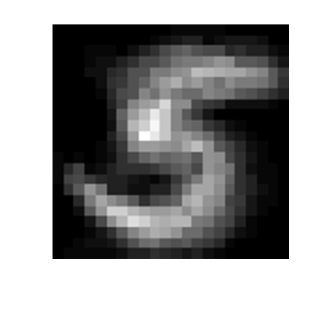
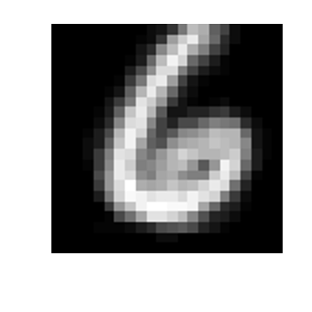
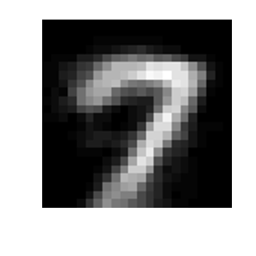
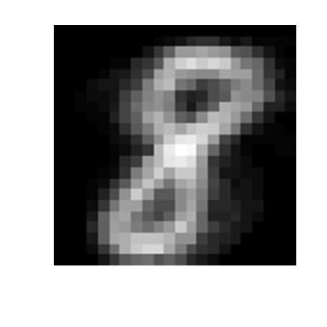
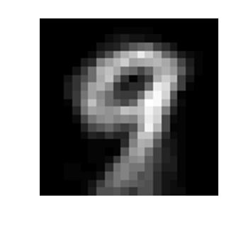
Learn-learn
sequence I
XI
XX
XXI
class
0
0
0
0
9
9
0
0
9
9
noise
dataset
mean
1
2
201
202
219
220
381
382
399
400
401
402
state #

Slide 3
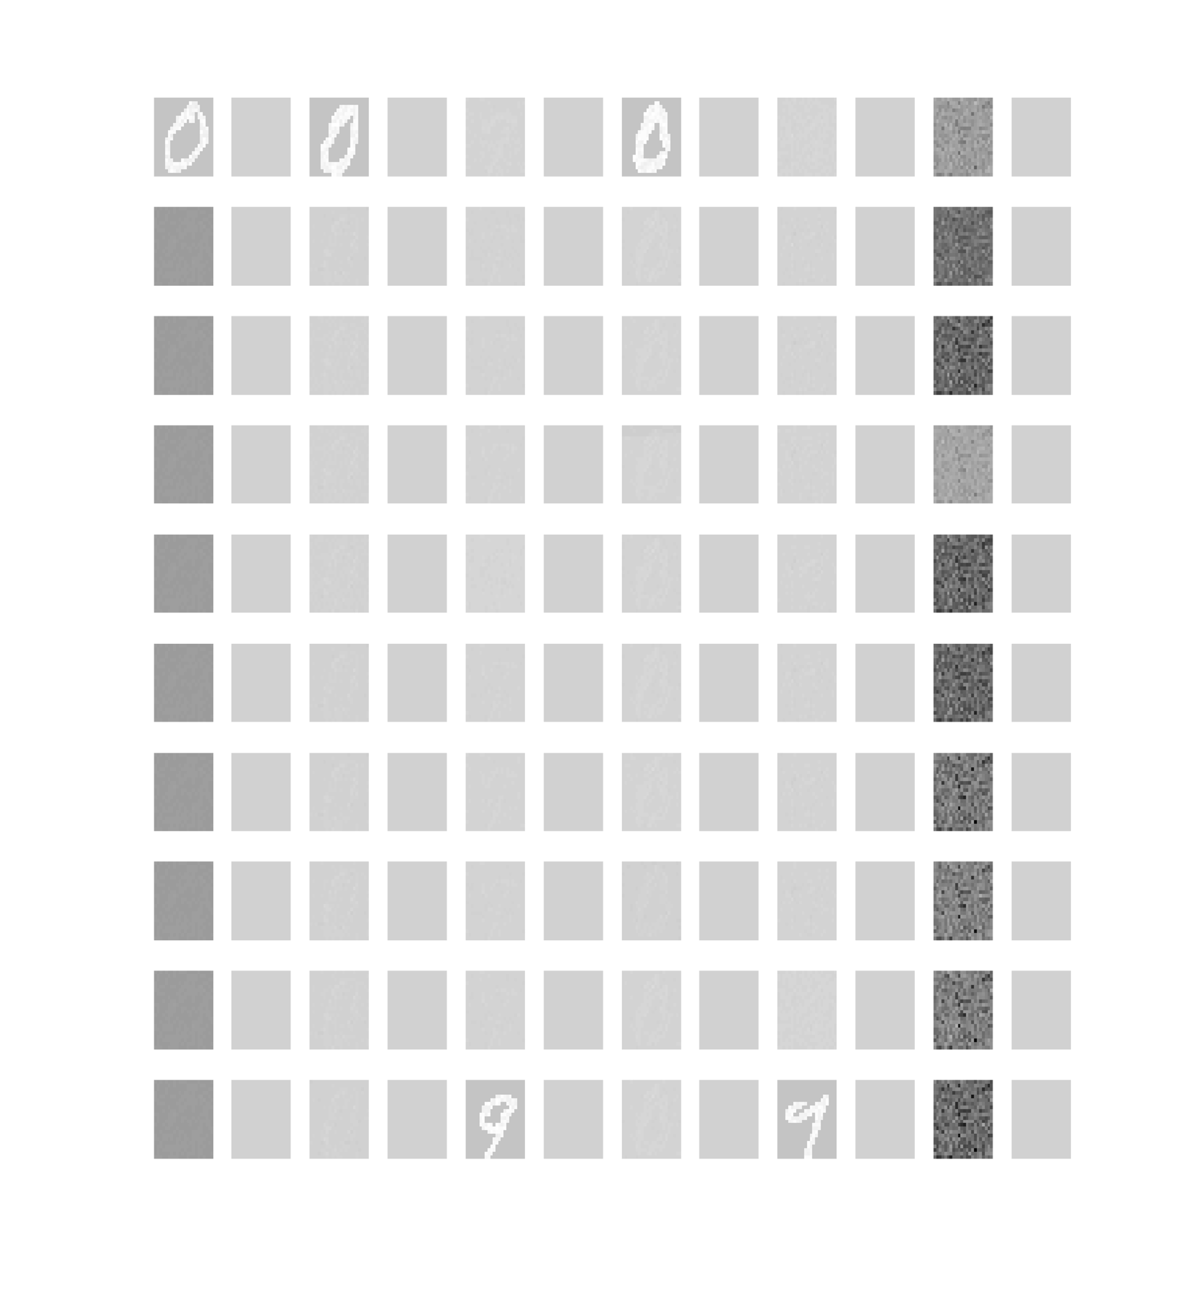
Reset
sequence I
XI
XX
XXI
class
0
0
9
0
9
noise
dataset
mean
1
2
201
202
219
220
381
382
399
400
401
402
state #

Slide 4
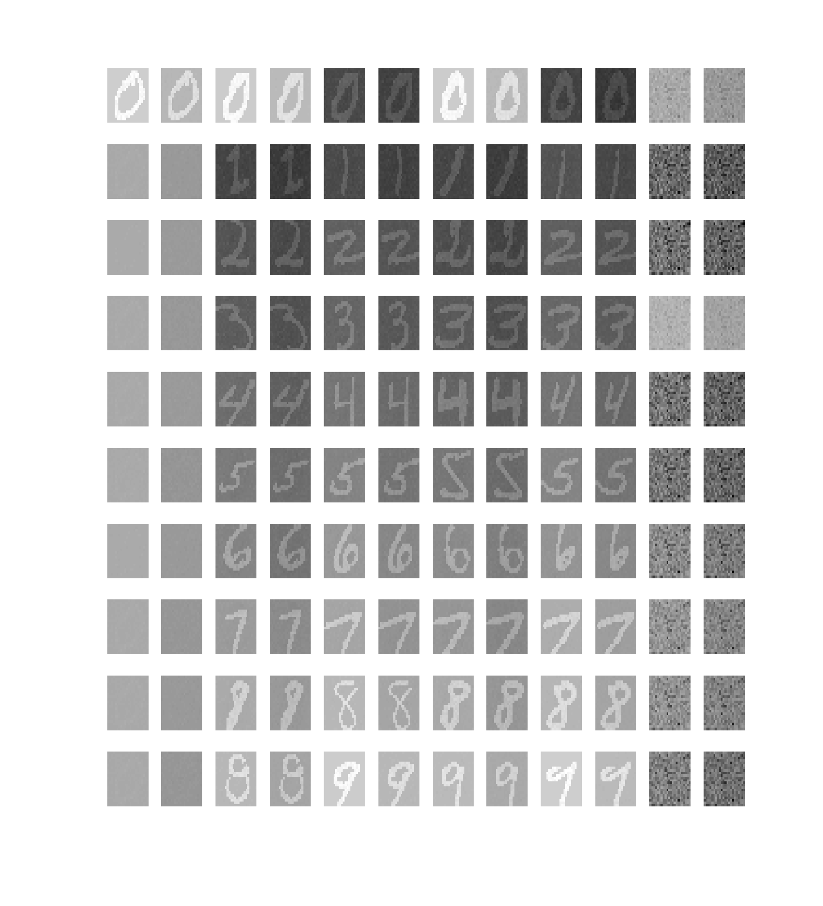
No BURST
sequence I
XI
XX
XXI
class
0
0
9
0
9
noise
dataset
mean
1
2
201
202
219
220
381
382
399
400
401
402
state #

Slide 5
Proposition before the deterministic simulation

Slide 6
digits
0
1
2
3
4
5
6
7
8
9
10
intermediaire
11
State #
29
Before noise
30
31
SUPPLEMENTARY MATERIAL
After noise
32
10
11
state #
29
30
31
32
0
1
2
3
4
digits
5
6
7
8
9

